Slide 1



Designing an appsuite for early detection of Parkinson’s disease using deep learning model.
CAPSTONE PROJECT PHASE-1
Phase – I Report
Submitted by -Malay Gupta 20BCE10069, Neelesh Shukla 20BCE10236, Vatsalya Singh 20BCE10044 , Jayant Gautam 20BCE10975, Siddhant Jain 20BCE10552
in partial fulfillment of the requirements for the degree of
Bachlore of Engineering and Technology
VIT Bhopal University
Bhopal
Madhya Pradhesh
September, 2023

Slide 2

Bonafide Certificate
Certified that this project report titled “Deep Learning Models for the Early Detection of Parkinson’s Disease using the motor-based symptoms.” is the bonafide work of : Malay Gupta 20BCE10069, Neelesh Shukla 20BCE10236, Vatsalya Singh 20BCE10044 , Jayant Gautam 20BCE10975, Siddhant Jain 20BCE10552 who carried out the project work under my supervision.
This project report (DSN4095-Capstone Project Phase-I) is submitted for the Project Viva-Voce examination held on …………..
Supervisor

Slide 3
Index
S.No. | Topic | Slide No.
1. | Introduction | 4
2. | Motivation | 5
3. | Objective | 8
4. | Existing work | 9

Slide 4
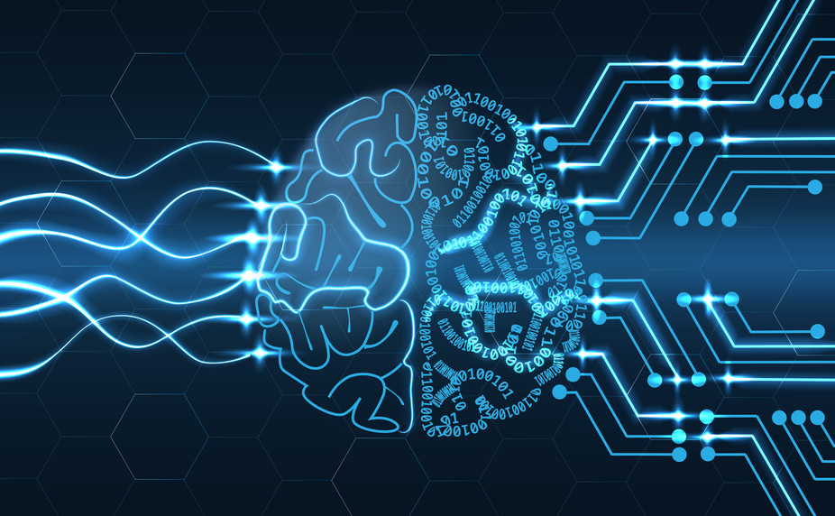
Introduction
The old age population is commonly affected with gait and balance disorders such as Parkinson’s disease (PD). PD is a progressive neurodegenerative movement disorder caused by the degeneration of substantia nigra dopaminergic neurons present in basal ganglia. Parkinson’s Disease (PD) is a disorder of the central nervous system that affects movement, often including tremors.

Slide 5
Motivation
According to the Parkinson Disease Foundation, one million Americans are living with Parkinson disease, and approximately 60,000 Americans are diagnosed with Parkinson disease each year. Similarly, 1.2 million Europeans suffer from it, and this number is forecasted to double by 2030.
The early detection of Parkinson’s Disease is a clinical challenge for the scientific community. Currently, no cure is available for the disease or the symptoms; therefore, movement therapy is important to delay the loss of motor function. Patients generally are clearly diagnosed with PD at the advanced stage; moreover, any neuroprotective therapy initiated at such a late stage may have fewer substantial effects on the disease progression. The Deep Learning Models can help in the early identification of Parkinson's Disease using the motor and non-motor symptoms, so that patients can receive the proper treatment and advice regarding care.

Slide 6
Datasets
Physionet Dataset
This database contains measures of gait from:
93 patients with PD (mean age: 66.3 years; 63% men)
73 healthy controls (mean age: 66.3 years; 55% men)
The database includes the vertical ground reaction force records of subjects as they walked at their usual, self-selected pace for approximately 2 minutes on level ground.
The output of each of these 16 sensors has been digitized and recorded at 100 samples per second, and the records also include two signals that reflect the sum of the 8 sensor outputs for each foot.
Daphnet Dataset
The dataset comprises of recordings of 3D acceleration at 64 Hz from 3 acceleration sensors.
The sensors are placed at the ankle (shank), on the thigh, and on the hip. The dataset was recorded in the lab with emphasis on generating many freeze events.
Users performed three kinds of tasks: straight line walking, walking with numerous turns, and finally a more realistic activity of daily living (ADL) task, where users went into different rooms while fetching coffee, opening doors, etc. The meaning of the annotations of the samples are as follows:
0: not part of the experiment. For instance, the sensors are installed on the user or the user is performing activities unrelated to the experimental protocol, such as debriefing.
1: experiment, no freeze (can be any of stand, walk, turn)
2: freeze

Slide 7
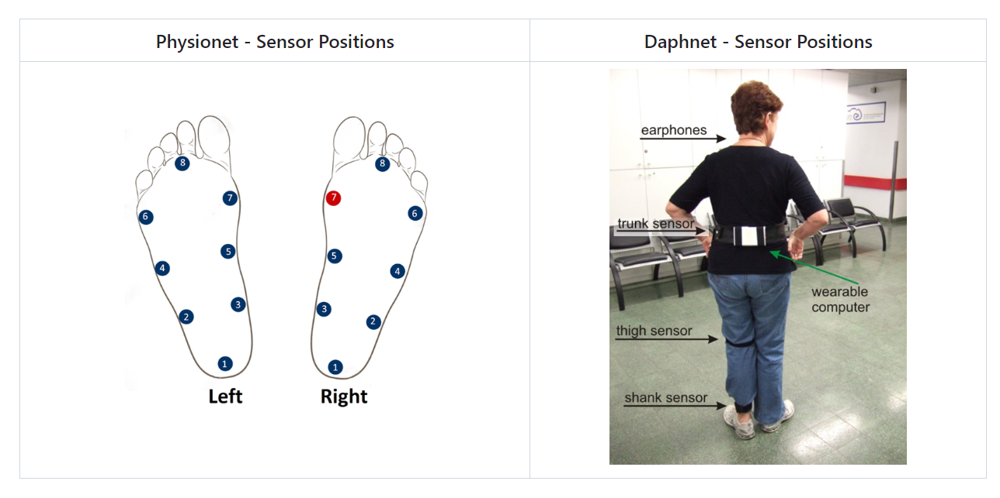

Slide 8
Objective
We will be designing a system that uses deep learning to detect Parkinson’s Disease at an earlier stage. Using the motor-based inputs we have developed deep learning models which detects motor-based symptoms in the subject’s body to subsequently detect the onset of Parkinson’s disease and also the severity of the Parkinson’s Disease based on the Hoehn Yahr Severity Scale.
The proposed project aligns with the broader objective of enhancing healthcare through the application of artificial intelligence and machine learning. By developing robust deep learning models for early Parkinson's detection, we can contribute to a more proactive and personalized approach to healthcare. This has the potential to reduce the burden on patients and caregivers, improve treatment outcomes, and allocate medical resources more efficiently.

Slide 9
Existing Work
Until recently, the gold-standard checklist for diagnosis came from the U.K.’s Parkinson’s Disease Society Brain Bank. It was a checklist that doctors followed to determine if the symptoms they saw fit the disease. But that’s now considered outdated. Recently, new criteria from the International Parkinson and Movement Disorder Society have come into use. This list reflects the most current understanding of the condition. It allows doctors to reach a more accurate diagnosis so patients can begin treatment at earlier stages.
There is no lab or imaging test that is recommended or definitive for Parkinson’s disease. However, in 2011, the U.S. Food and Drug Administration approved an imaging scan called the DaTscan. This technique allows doctors to see detailed pictures of the brain’s dopamine system.
A DaTscan involves an injection of a small amount of a radioactive drug and a machine called a single-photon emission computed tomography (SPECT) scanner, similar to an MRI.
The drug binds to dopamine transmitters in the brain, showing where in the brain dopaminergic neurons are. (Dopaminergic neurons are the source of dopamine in the brain; a loss of dopamine is what leads to Parkinson’s.)
The results of a DaTscan can’t show that you have Parkinson’s, but they can help your doctor confirm a diagnosis or rule out a Parkinson’s mimic.

Slide 10
Conclusion
In conclusion, the project proposal for early detection of Parkinson's disease using deep learning presents a promising avenue for improving the diagnosis and treatment of this debilitating condition. By leveraging the power of machine learning algorithms, the project aims to identify early signs and symptoms of Parkinson's disease, enabling timely interventions and more effective treatment strategies.
The utilization of deep learning techniques offers several advantages in this context. Deep learning algorithms can process large amounts of data and extract intricate patterns that may not be apparent to human observers. By training these algorithms on comprehensive datasets that include various clinical markers and symptoms associated with Parkinson's disease, we can develop accurate models capable of identifying subtle indicators that may precede the onset of the disease.

Slide 11
Thank You

